Slide 1
Using your Nook is a privilege in PRR you earn!!

Slide 2
Nook Training for PRR Kids

Slide 3
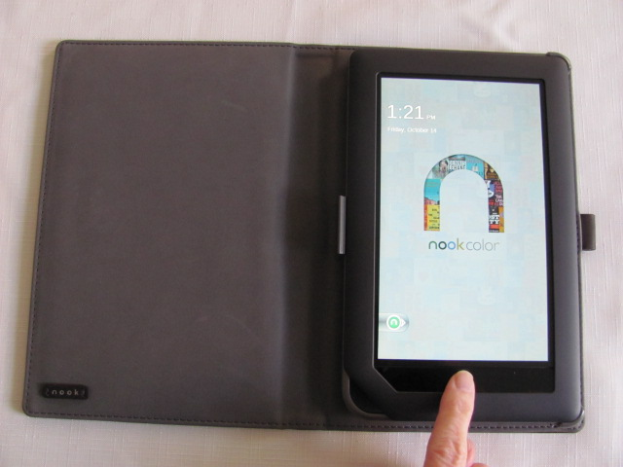
Wake up your Nook! Press the “nook” button

Slide 4
Nook home page Swipe the Green circle

Slide 5
Nook Home Page

Slide 6
To read a book Press “n” button

Slide 7
Tap on “Library” at bottom of screen

Slide 8
Select a book Tap screen lightly on book

Slide 9
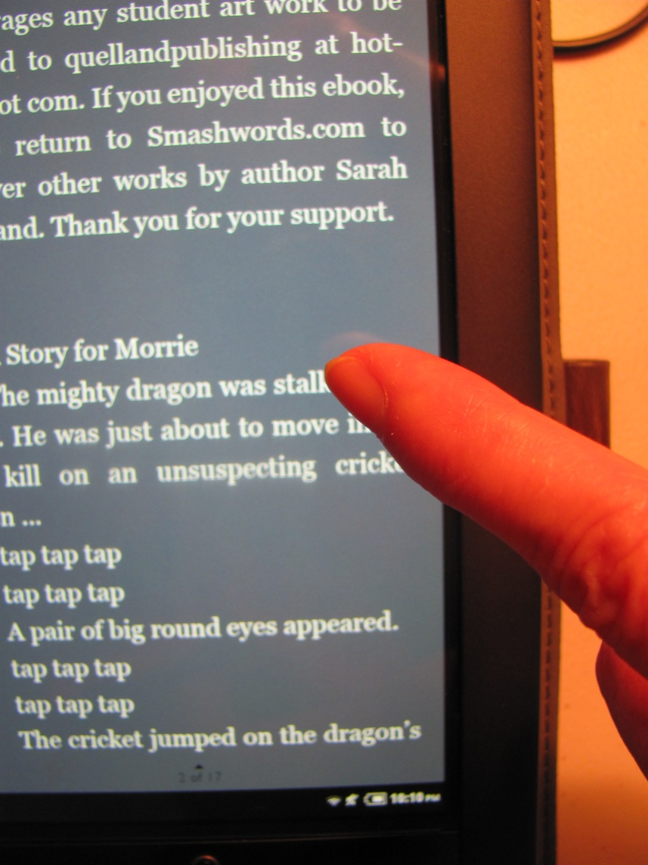
Some books you read to yourself Tap the right side to turn a page

Slide 10
Some books are “Read to Me” books tap the book

Slide 11
Book will open and load

Slide 12
“Read to me” books load horizontally turn your Nook sideways

Slide 13
Tap “Read to Me”

Slide 14
Book opens to first page

Slide 15
Turn page Tap right side of screen

Slide 16
To go back one page Tap left side of screen

Slide 17
To close a book press “n” button

Slide 18
A window pops up

Slide 19
Choose Library if you want a new book Choose the Home picture if you are done

Slide 20
This takes you back to “home”

Slide 21
Nooks are set to go to “sleep” after 2 minutes of inactivity Press “nook” button to wake up Nook

Slide 22
To put Nook to “sleep” Tap side button

Slide 23
Apps on Your Nook Press the “n” button

Slide 24
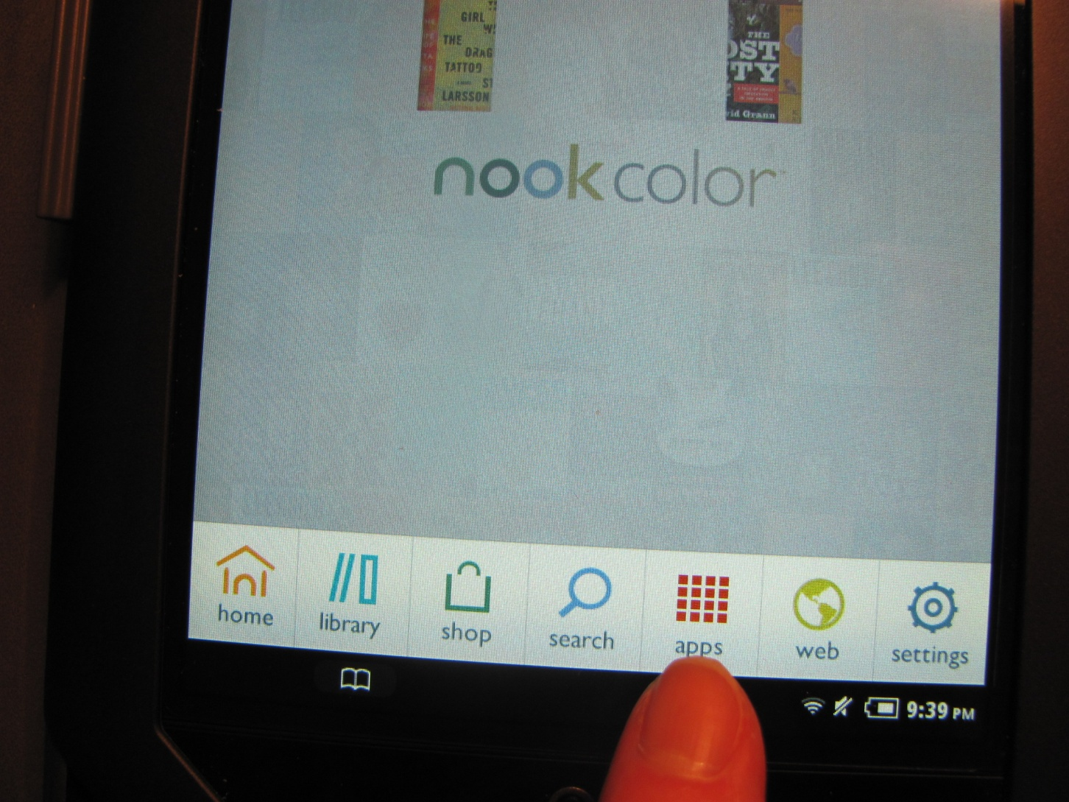
Press the App icon at bottom of screen

Slide 25
Choose your App by tapping it’s icon

Slide 26
Play the game

Slide 27
When you are done, Press the “n” button, choose home

Slide 28
Nook Training – PRR Website

Slide 29
To go to the PRR website press the “n” button

Slide 30
Choose the “web” picture

Slide 31
This takes you to the PRR website

Slide 32
Now you can choose a reading link

Slide 33
Reading sites read stories to you.

Slide 34
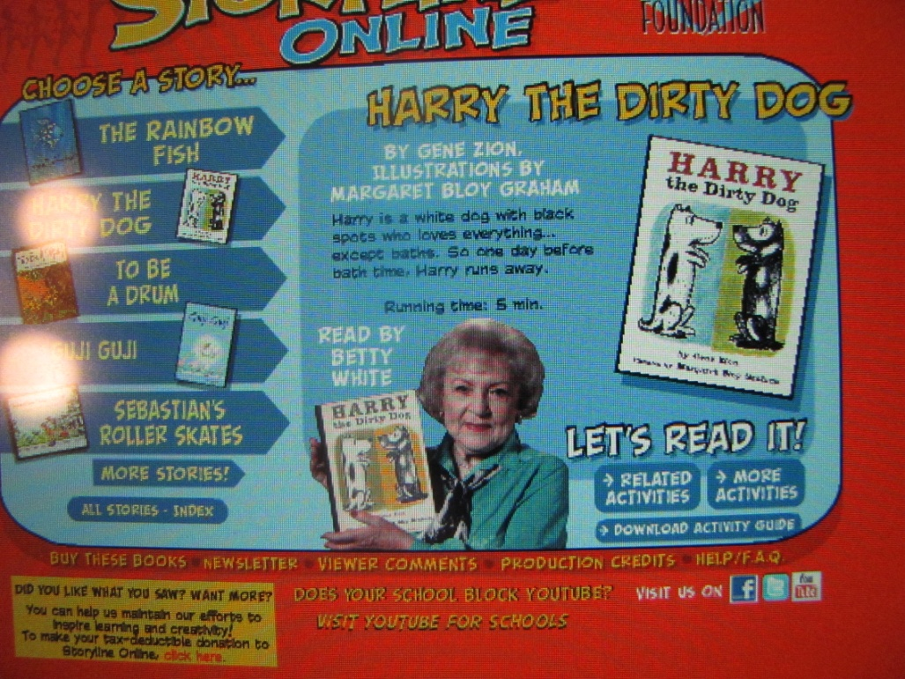
Choose a story

Slide 35
The story begins, Enjoy!

Slide 36
Headphones plug in the little round hole in top of Nook

Slide 37
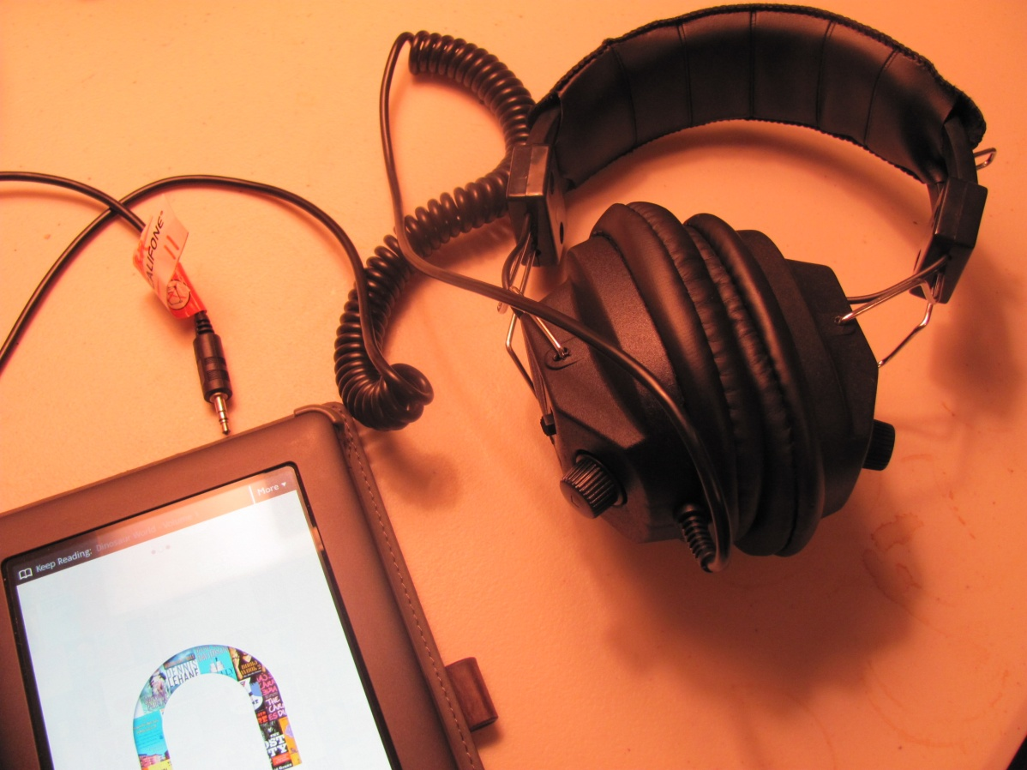
Plug in headphones as far in as they will go

Slide 38
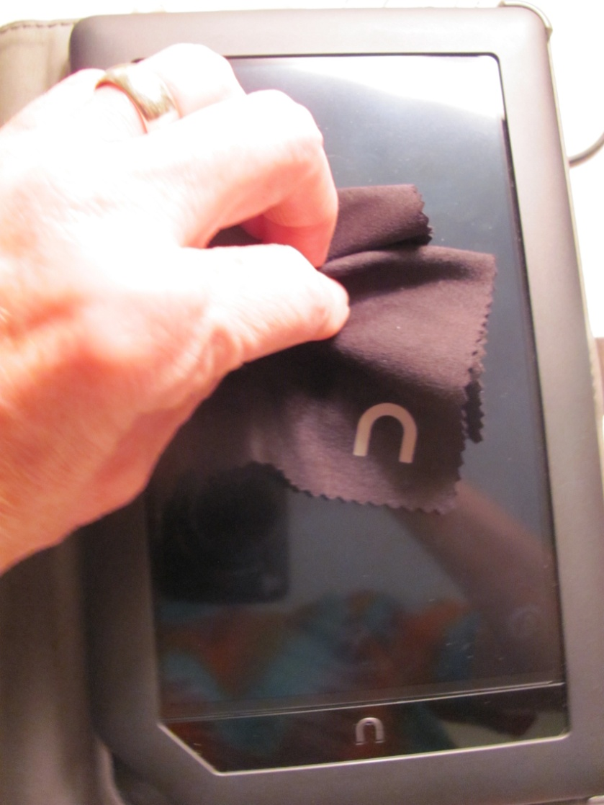
To Clean smudges off your Nook screen use the dry black “Nook” cloth

Slide 39
Care for your Nook
Use the black Nook rag to clean the screen gently.
Let the PRR Leader know if your Nook battery is low.
Leave the screen protector in place. Your Nook will last longer and your screen won’t get scratched.
Use your assigned Nook.
Put Nooks and headphones away in correct place when done using.

Slide 40
Nook User Agreement
Remember, students may only use the PRR website or the apps the PRR Leader has approved.
Some Apps may be for Funtanstic Fridays Only!
Enjoy your Nook!

