Slide 1
New Nooks for PRR 2013
5 new nooks have been purchased for each PRR group.
These nooks are a tiny bit different than the regular nooks.
These nooks are only for 3rd and 4th Graders.

Slide 2
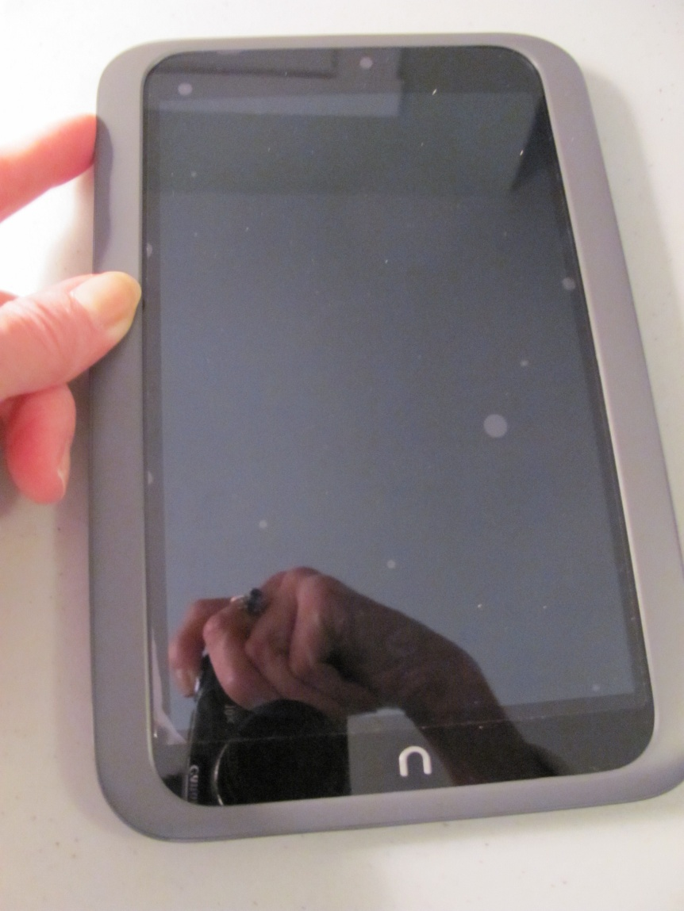
New nooks are similar to the old nooks
Wake up the nook on the side button.

Slide 3
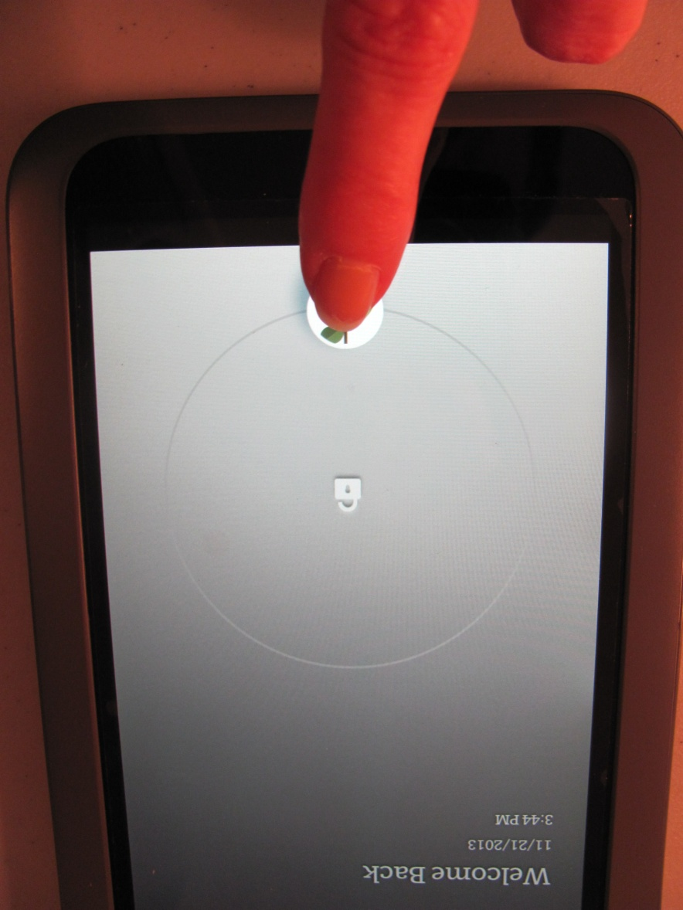
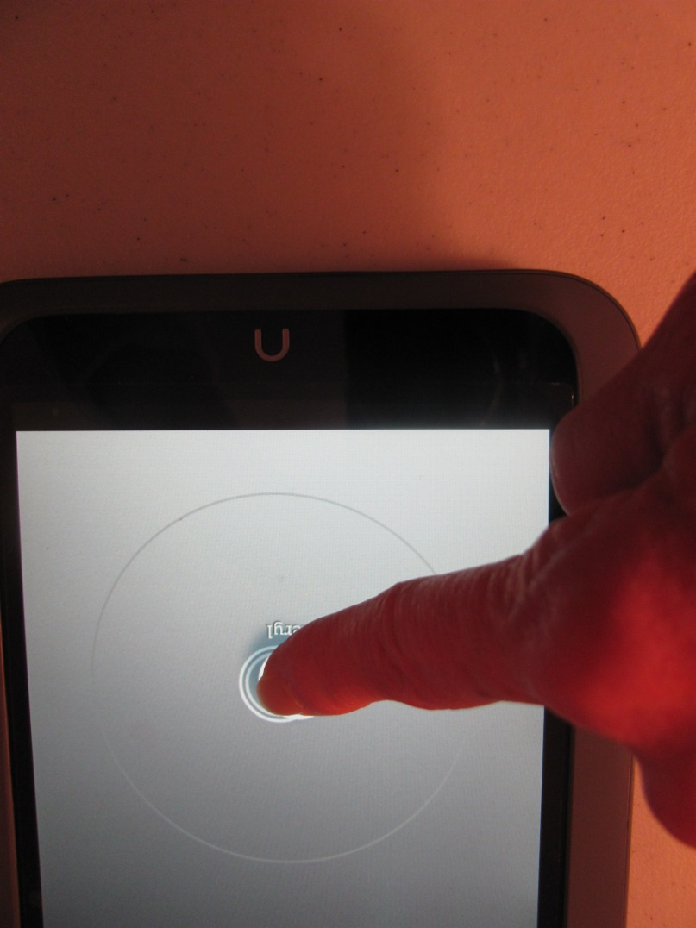
Unlock your nook
Drag the green apple to the lock symbol.

Slide 4
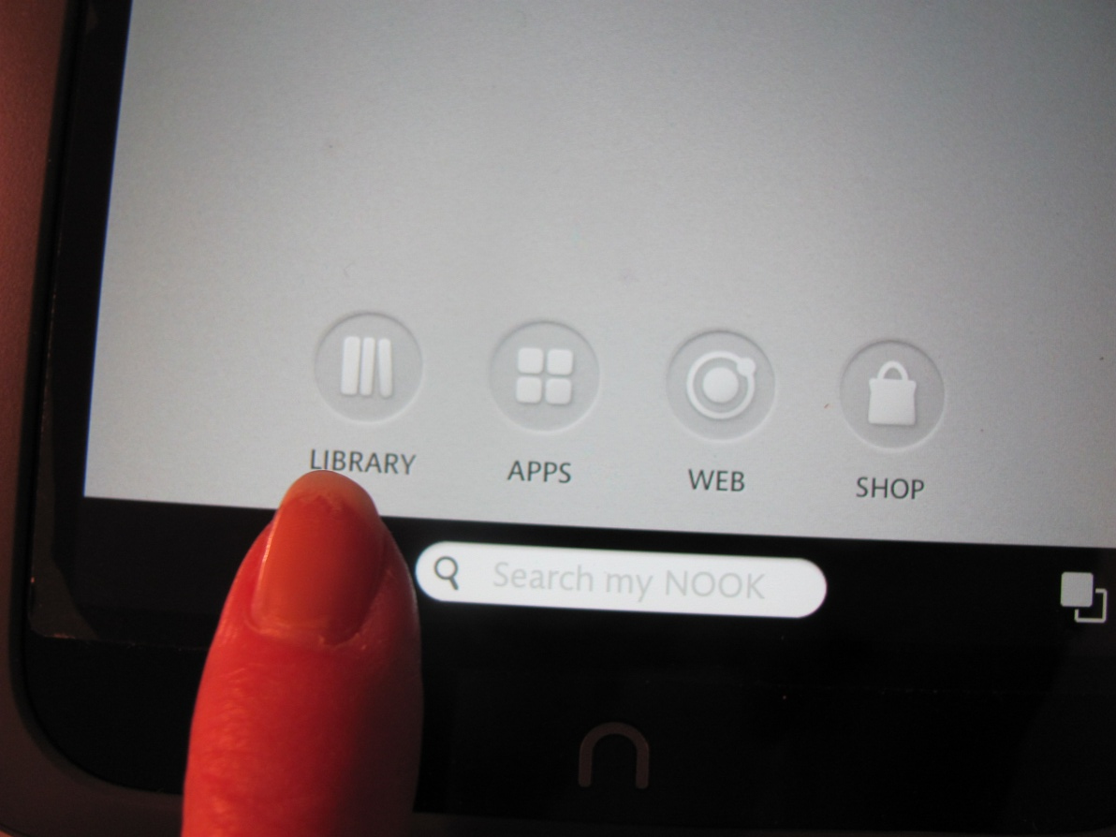
The new home page
Choose a place to go on the nook
at the bottom of the screen

Slide 5
Shop is “Off Limits” to PRR Kids
That’s Mrs. Geiger’s job!!

Slide 6
Library
Choose a book!

Slide 7
Two new books for 3rd and 4th Gr.
Check out the new
Diary of a Whimpy Kid Book 8
(I hear it’s really funny!)
Check out Shiloh. This is a powerful story about a brave boy saving a dog from a bad situation. This book won an award!!
There are more Shiloh books if you like this one!
(Jordan at Blackhurst gives it 2 thumbs up!)

Slide 8
Apps
Only use Brain Quest for now.

Slide 9
All nooks have Brain Quest!
Give your brain a work out and try to solve problems while on a journey. Put on your thinking cap, you don’t have a lot of time!
Nooks 1-12 have Brain Quest for Gr. 1 & 2.
Nooks 13-26 have Brain Quest for Gr. 3 & 4.

Slide 10
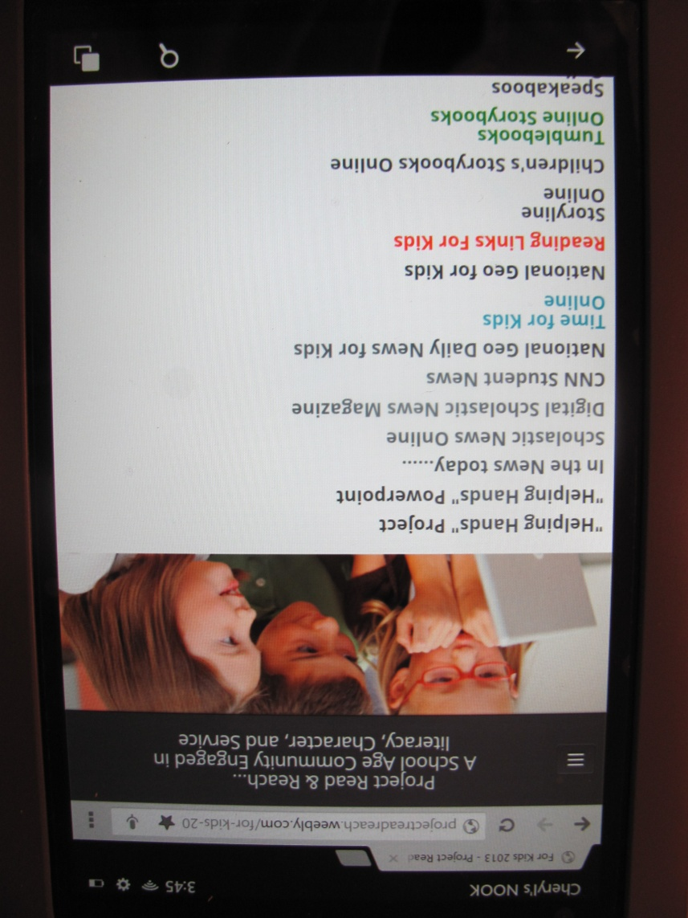
Web
You may only visit websites that are on the PRR website Kid’s page.

Slide 11
Expectations for all students:
Stay on websites that are on the PRR website.
Leave the nook’s settings alone. Don’t change anything.
Don’t download anything to the nooks.
Put your nook away after each use.
Take care of your headphones.
Leave the screen protector film alone.
Clean your nook screen with a dry nook rag to get the oil off the screen.

Slide 12
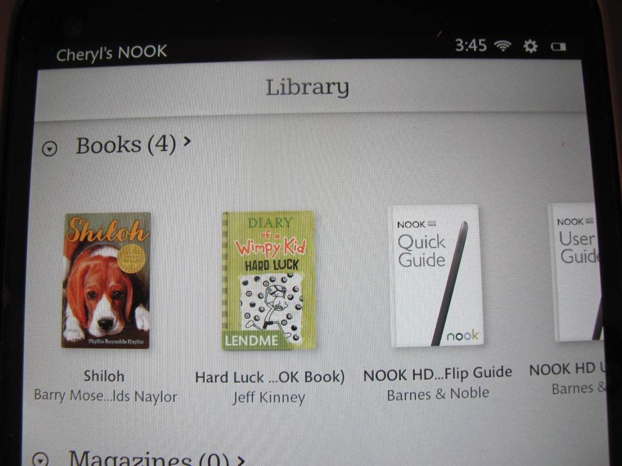
Good News!
PRR now has enough nooks for all students!
Start reading on yours today!!

